Slide 1
Teaching Math
Dr. Fawzia Mai Tung, TER

Slide 2
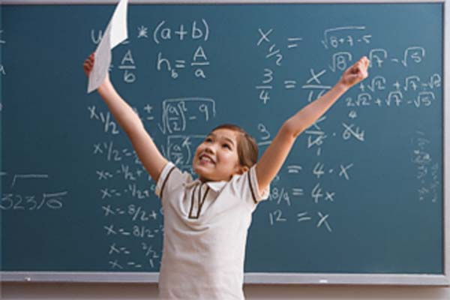
A successful Math program
Premises:
No such thing as Math genes missing
Grade school Math is easy
Why do we accept that only a few students can succeed in math?
What is a successful Math program?
Successful means all students should be able to get A’s and B’s (80% or more)
To successful teach Math from PreK to Grade 12, you need:

Slide 3
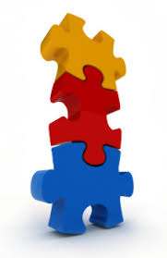
Three components
Curriculum:
Singapore Math
Tool and skill honing:
Abacus
Tricks and tips
Testing and filling gaps:
At start of school year
Incoming students
Whenever students have trouble progressing

Slide 4
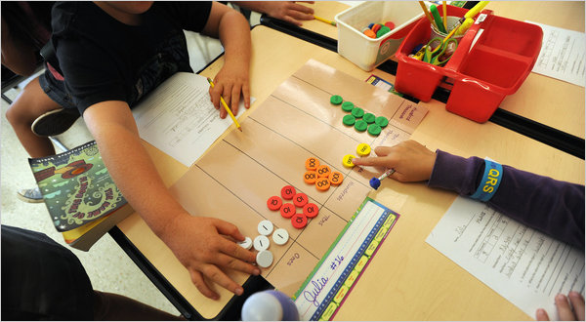
Singapore Math
National syllabus in Singapore
Consistently scores at top of the world in international studies and competitions
Characteristics:
In English
Early mental math
Spiraling
More depth than width
Visual / kinetic to symbolic

Slide 5
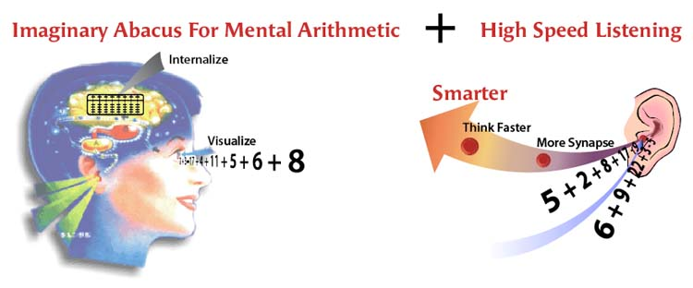
Mental Abacus
Goals:
Mentally add and subtract any numbers
In seconds
Mentally multiply and divide any numbers
Develop cognitive skills
Sharpen sensory skills
May be started as early as 3 years of age

Slide 6
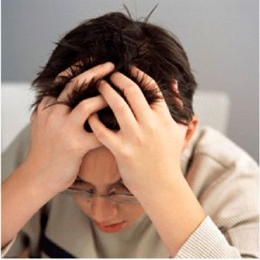
Testing & filling gaps
Done at start of every school year
Identify individual weaknesses.
Remedy weaknesses:
Tutoring
Pull-out sessions
Peer tutoring

Slide 7
Special concerns
A few

Slide 8
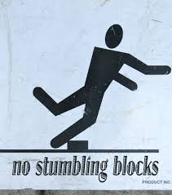
Stumbling blocks
Diverse learning styles
Mastering arithmetic facts:
Addition, subtraction, multiplication, division
Grasping concepts
Visualizing word problems

Slide 9
Student Diversity
Various learning styles/modalities
1. Visual
2. Auditory
3. Tactile (Kinesthetic)
Multiple intelligences
Musical: rhythmic & harmonic
Visual: spatial
Verbal: linguistic
Logical: mathematical
Bodily: kinesthetic
Interpersonal
Intrapersonal
Naturalistic
Existential

Slide 10
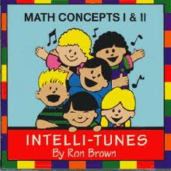
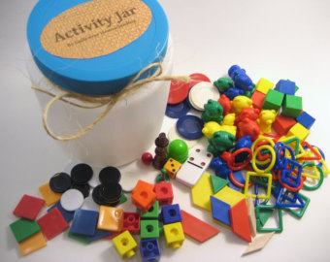
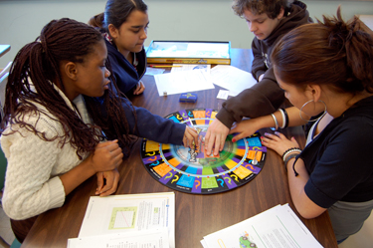
Applications in math
Use concrete objects
Use songs and movements
Draw symbolic representations
Write about word problems
Relate word problems to real life

Slide 11
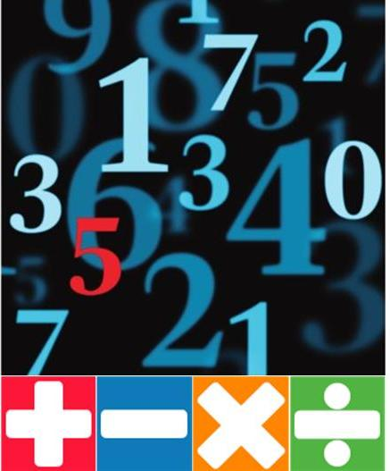
Arithmetic
Addition & subtraction: abacus
Multiplication tables: MUST memorize/ 3 sec
Good old rote memorization
Songs
Movements
Finger Tricks
Charts
Repeat daily till mastered
Do not assume subtraction & division are mastered as opposite of addition & multiplication

Slide 12
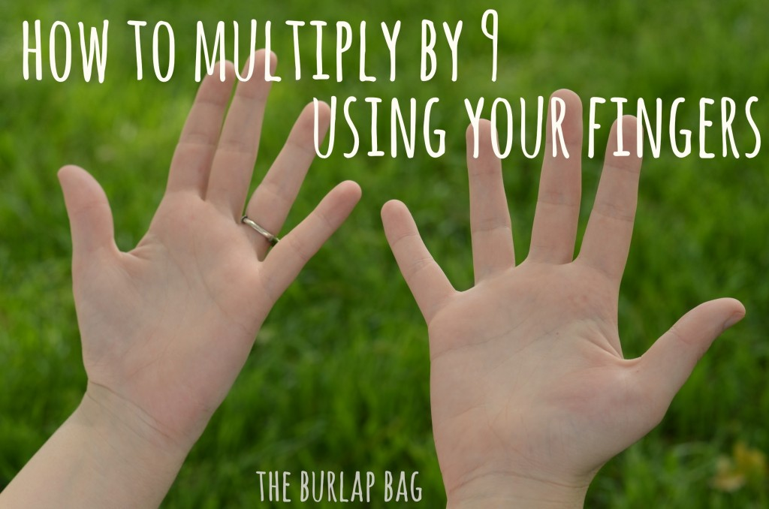
Finger Trick: table of 9
finger trick for table of 9
Open both hands facing you
Number fingers from left to right
Bend down the finger you multiply
Read fingers left standing:
On the left: tens
On the right: units

Slide 13
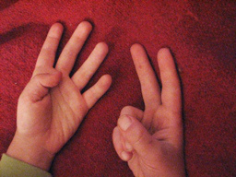
multiplying numbers 6 and above
Open both hands facing you
Each hand represents a number
Multiply only numbers 6, 7, 8, 9,10
Example: 7x8
Left hand: (5 in head), 6,7 (bend down little finger, and 4th finger). This is 7.
Right hand: (5 in head), 6, 7, 8 (bend down little finger, 4th finger, middle finger). This is 8.
Read bent fingers: 5. This means 50.
Multiply standing fingers: 3x2=6
50+6= 56

Slide 14
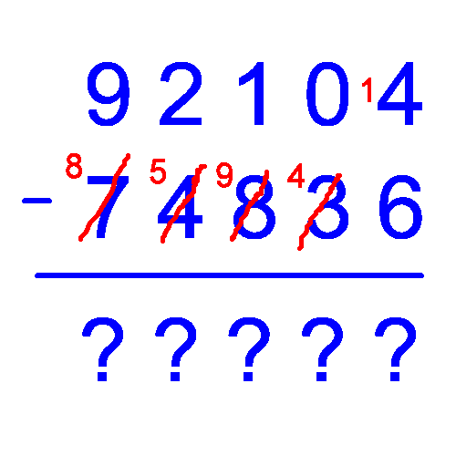
Subtraction: french method
= Austrian/ European continental method
Based on idea that subtraction= difference
Very helpful for children with difficulty concentrating, or going step by step.
Especially helpful with large numbers.

Slide 15
french subtraction -- how
50 – 18
5 1 0
5 1 0
- 1 8
- 11 8
4 2
4 2

Slide 16
US method
50-18
0-8, cannot be.
Cross out 5, make it 4
Regroup to ten, add it to 0
10-8=2
4-1=3
Answer: 32

Slide 17
French method
50-18
0-8, cannot be.
Borrow, return
10-8=2
5-2=3
Answer: 32

Slide 18
More complex subtraction
3
9
9
4 10 10 10
4 10 10 10
-
2 8 4 9
-
12 18 14 9
1 1 5 1
1 1 5 1

Slide 19
More complex subtraction
3
9
0
1
4 0 1 3
4 0 1 3
1
1
1
1
1
-
1 8 6 9
-
1 8 6 9
1
1
1
2 1 4 4
2 1 4 4

Slide 20
Comparing both methods
More steps
Easy to confuse
Moving vertically and horizontally back and forth
Less steps
Always same step
Only moving vertically one column at a time
US Method
French Method

Slide 21
Thank you!

