Slide 1
Singapore Math
Important issues

Slide 2
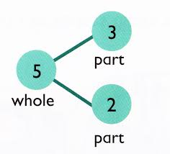
Early Grades
Concrete – Pictorial – Abstract Approach
Number bonds
Subtraction:
Take away
Difference
Mental re-arrangements to facilitate
Addition
subtraction

Slide 3
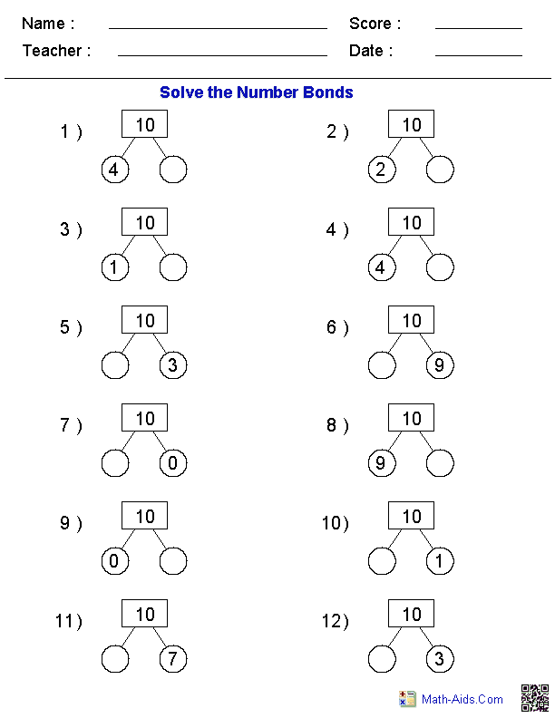
Number Bonds
Practice using worksheets
Practice using games
Online game:
online game for number bonds

Slide 4
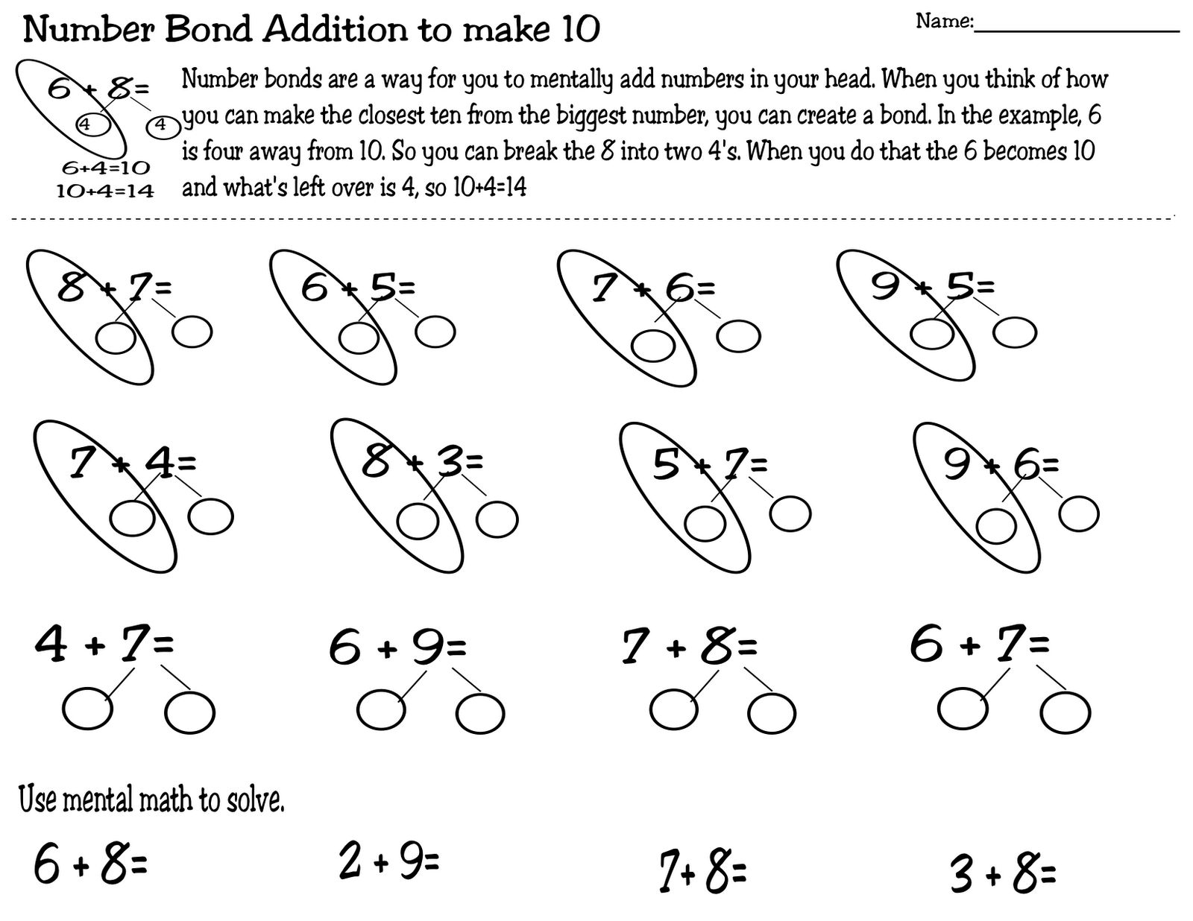
Using number bonds to add up to 20

Slide 5
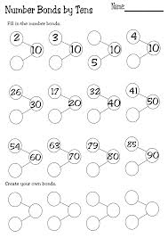
Practicing Number Bonds up to 20

Slide 6
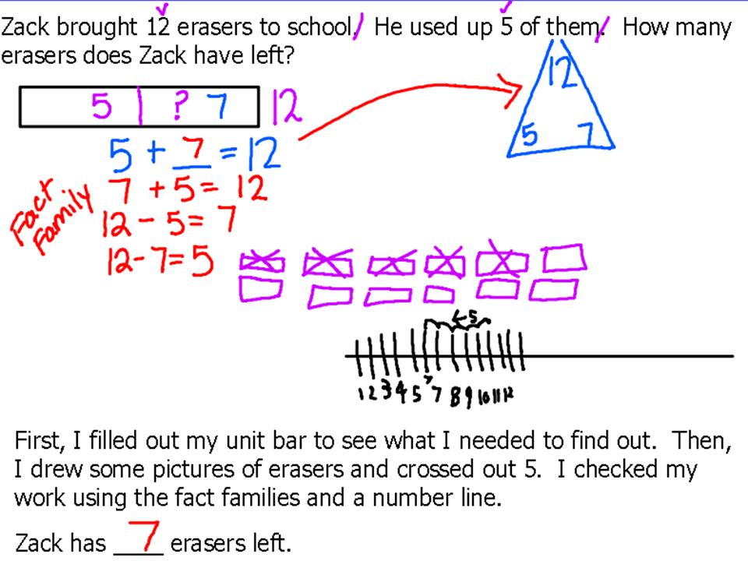
Steps in problem solving

Slide 7
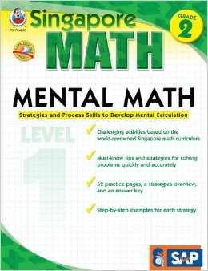
Other Resources
Supplementary books

Slide 8
Visual Algebra
Representation of quantities using bars
Make sure to train students on the use of bars early on, even though it may seem redundant at first.
+/- word problems:
Two types of bar representation
Side by side
Aligned

Slide 9
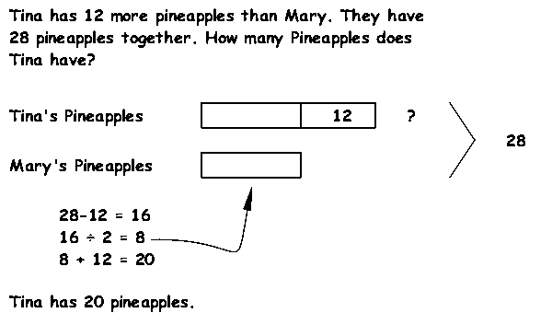
Using Bars With Word Problems

Slide 10
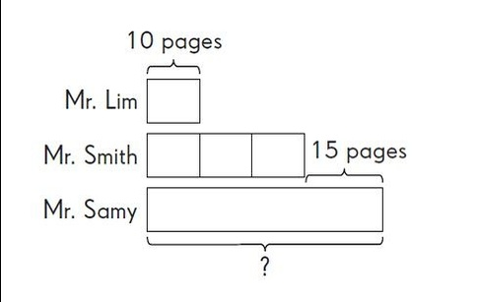
Using Bars With Word Problems

Slide 11
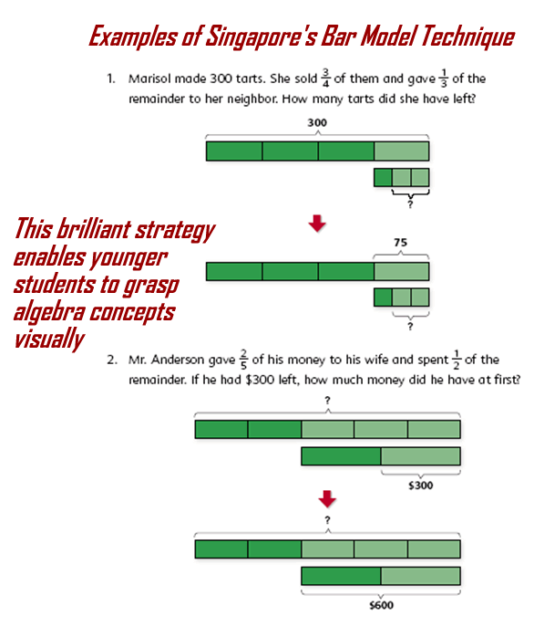
Using Bars With Word Problems

Slide 12
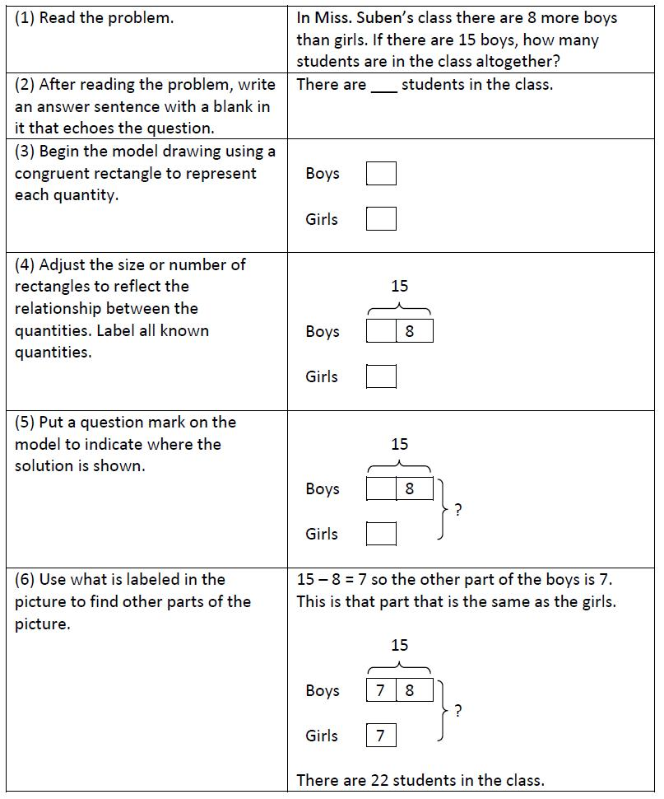
Steps in Using Bar Diagrams – 1 –

Slide 13
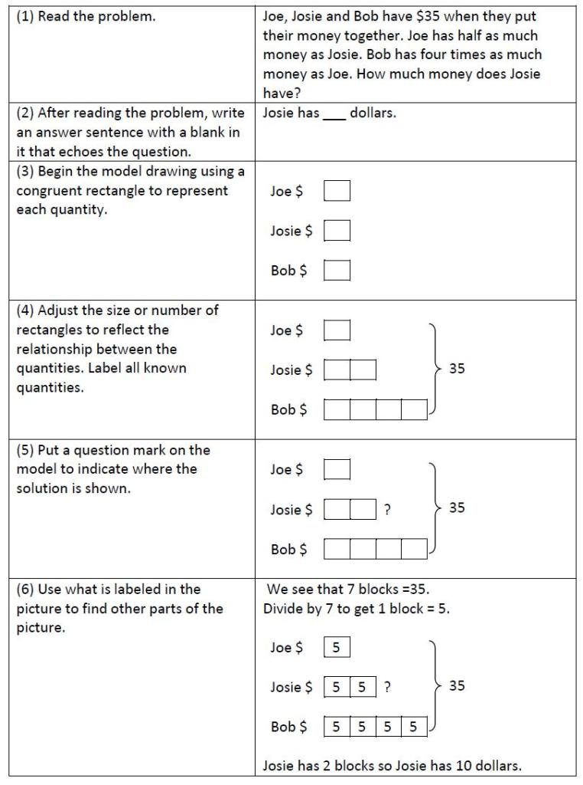
Steps in Using Bar Diagrams – 2 –

Slide 14
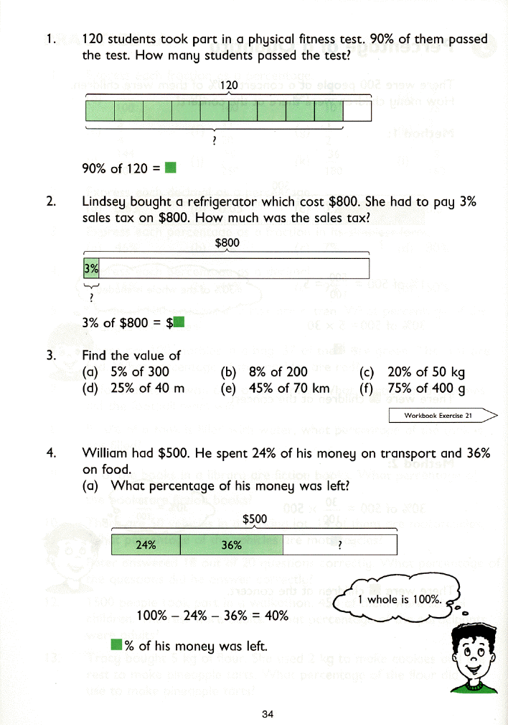

Slide 16
More Practice for Number Bonds

Slide 17
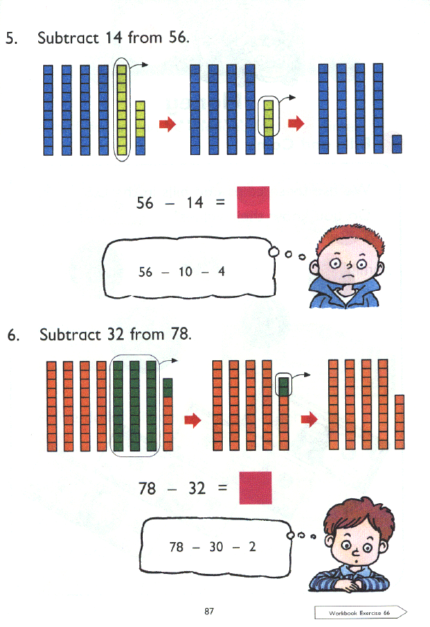
Mental Steps For Addition and Subtraction

Slide 18
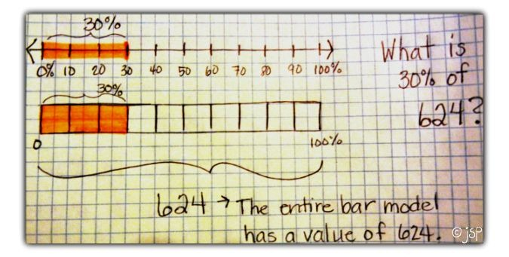
Percentages

Slide 19
Steps For Model Drawing

Slide 20
Comparing Traditional and Singapore Approaches -- 1 –

Slide 21
Comparing Traditional and Singapore Approaches -- 2 –

Slide 22
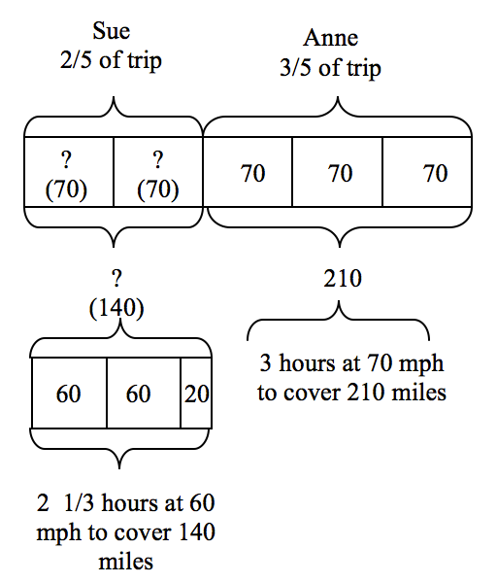

Slide 24
Online Resources
Youtube clips

Slide 25
About Singapore Math
What is Singapore Math?
CPA approach
Introduction to Singapore Math –1
Introduction to Singapore Math –2
Why Singapore Math Leads the World

Slide 26
Number Bonds, Addition & Subtraction
Number Bonds
Understanding Number Bonds
Number Bonds in Kindergarten
Number Bonds in Kindergarten 2
Number Bonds in Kindergarten 3
Addition and Subtraction – 1
Addition and Subtraction – 2
Addition and Subtraction – 3

Slide 27
Multiplication & Division
Multiplication
Multiplication word problem
Multiplication word problem 2
Multiplying a mixed number with a whole number
Division word problem

Slide 28
Problem Solving
Problem Solving
Problem solving – 2
Model Approach
Grade 7 word problem
Grade 7 word problem – 2

Slide 29
Algebraic problem solving 1
Algebraic problem solving 2
Algebraic word problem 3
Algebraic word problem 4
Algebraic word problem 5
Algebraic word problem 6

Slide 30
Fraction word problem 1
Dividing fractions
Fractions with different denominators, word problems

Slide 31
Primary School Leaving Exam (PSLE) Problems
PSLE: Primary School Leaving Exam
PSLE problem 1
PSLE Problem 1-charted details
PSLE problem 2
PSLE problem 3
PSLE Guess and Check
PSLE speed problem

Slide 32
Thank You!
For further details, questions, suggestions
Contact:
ftcmt53@gmail.com
www.tungeducation.com

