Slide 1

Mental Abacus
Lesson 1

Slide 2
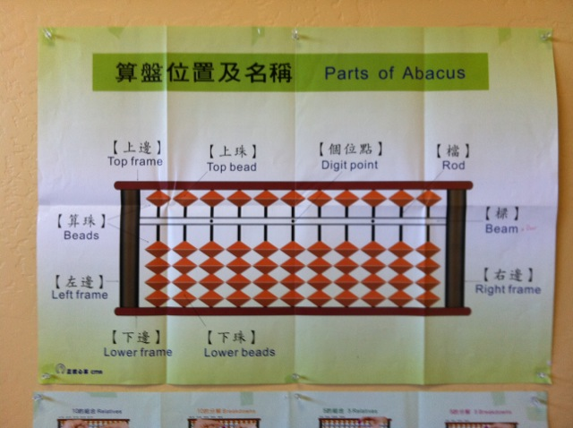
Parts of the abacus

Slide 3
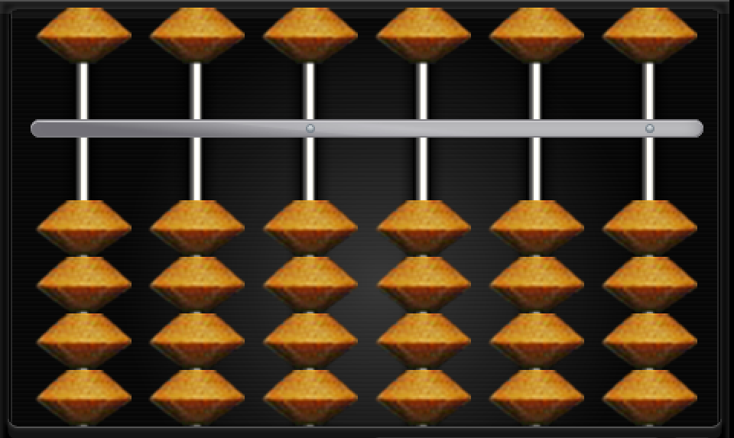
Rods: represent place values
Hundred thousands
Ten thousands
Thousands
Hundreds
Tens
Ones

Slide 4
Lower Beads: represent units
1
1
1
1
100
100
100
100
10 10 10 10

Slide 5
Upper beads: represent 5 units
5000 500 50 5

Slide 6

Two-hand method:
General rules:
Use right fingers for unit rod
Use left fingers for tens rod

Slide 7
Lower beads
Use right (Rt) thumb (T) to push up lower beads
Use right (Rt) index to:
  Push down lower beads

Slide 8
Upper beads
Use right (Rt) index to push down upper beads
Use right (Rt) index to push up upper beads

Slide 9
Neutral position (0)
Upper beads aligned along upper frame
Lower beads aligned along lower frame

Slide 10
How to reset abacus to neutral position
Run thumb and index fingers along either sides of the beam.
Or: stand the abacus up, to slide all lower beads down (through gravity). Lay abacus flat. Use nail of index (or head of pencil) to run along upper side of beam.

Slide 11
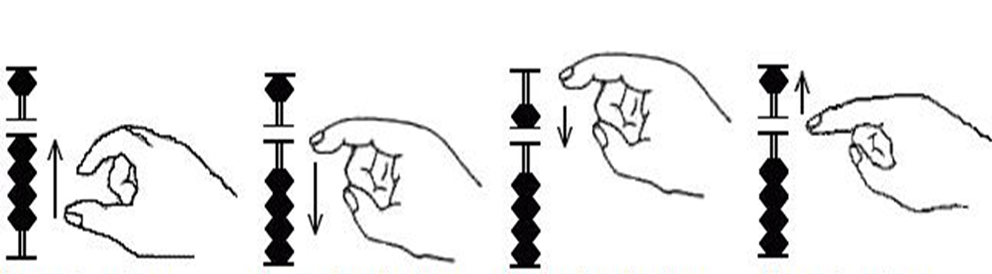
Showing numbers
Lower beads: +
Push
up
Lower beads:
-
Push down
Upper beads:
+
Push down
Upper beads:
-
Push
up
+4
-4
+5
-5

Slide 12

Hand position
Holding a pencil:
  Right hand
  Eraser faces left
Use only index and thumb to push beads
Easily shift pencil to writing position

Slide 13
Designate a Unit rod using the digit point.
This dot will indicate that this rod represents ones.

Slide 14
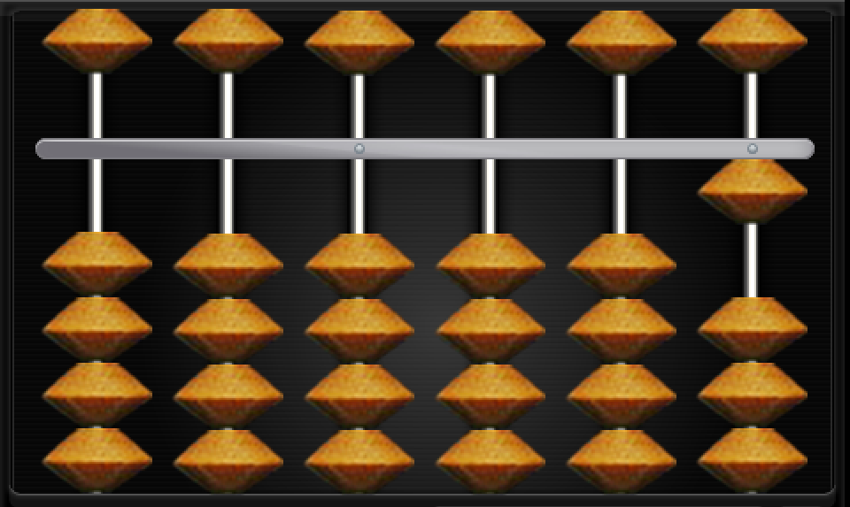
Plus 1 -- minus 1
Notes:
Use right thumb to push up (+1); use right index to push down (-1).

Slide 15
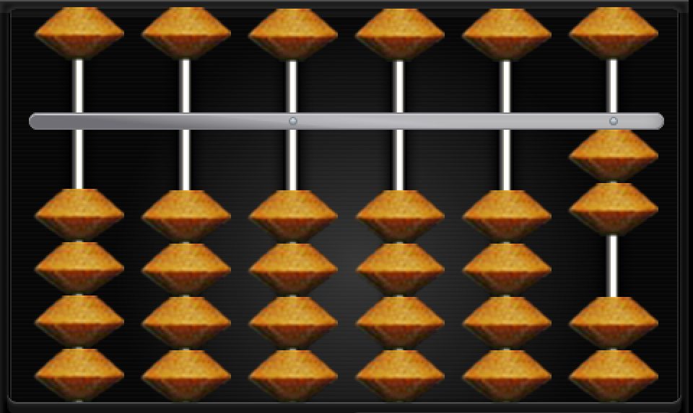
plus 2 -- minus 2
Notes:
Use right thumb to push up (+2); use right index to push down (-2). Both beads together.

Slide 16
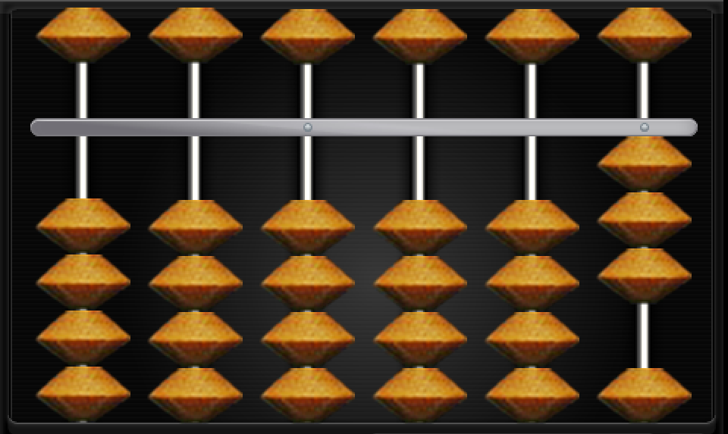
plus 3 -- minus 3
Notes:
Use right thumb to push up (+3); use right index to push down (-3). All 3 beads together.

Slide 17
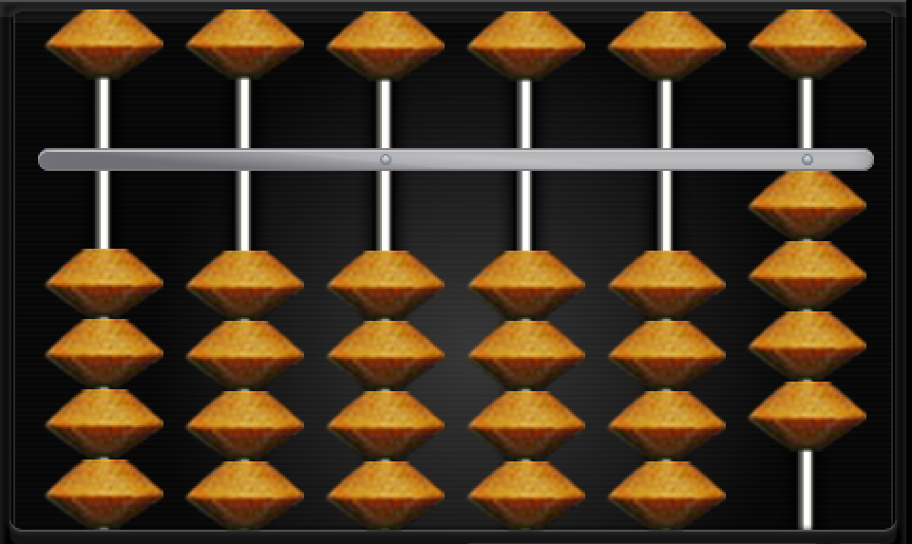
plus 4 -- minus 4
Notes:
Use right thumb to push up (+4); use right index to push down (-4). All 4 beads together.

Slide 18
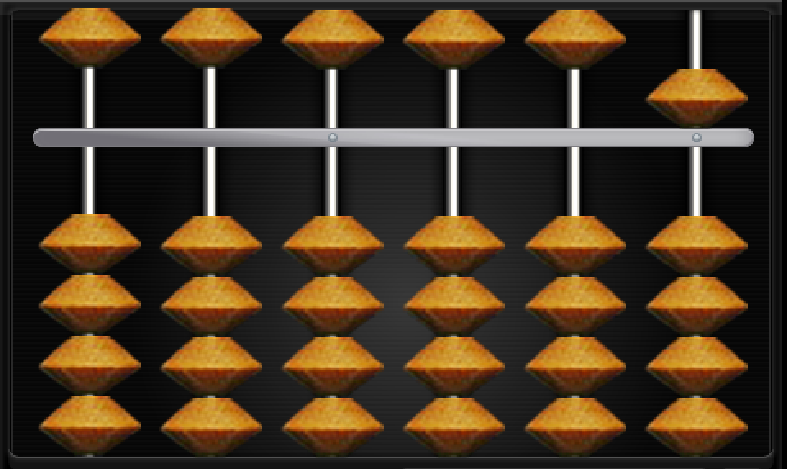
Plus 5 -- minus 5
Notes:
Use right index to push the bead up and down.

Slide 19
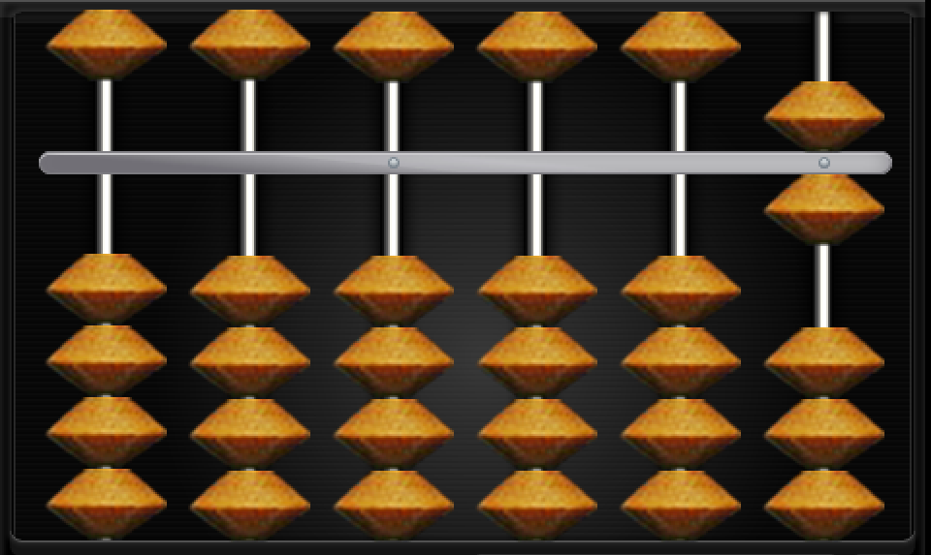
Plus 6 -- minus 6
Notes:
Pinch to add 6; flick to minus 6. Use both index and thumb simultaneously.

Slide 20
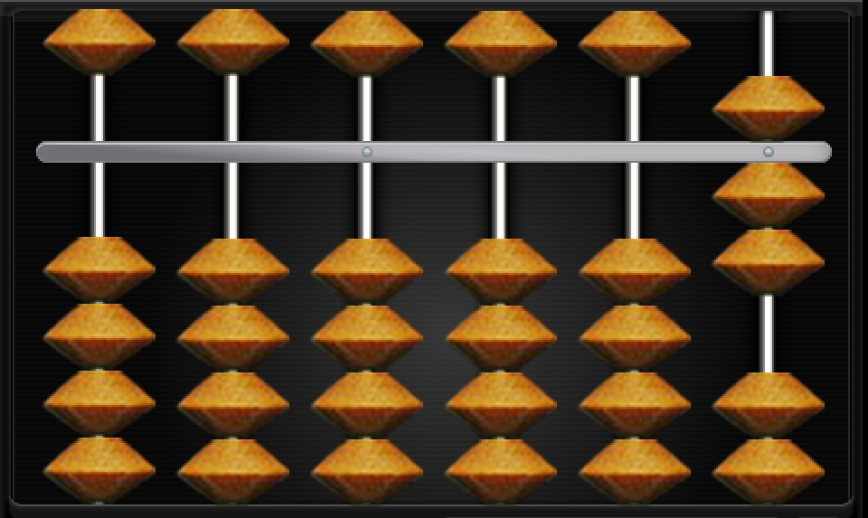
plus 7 -- minus 7
Notes:
Pinch to add 7; flick to minus 7. Use both index and thumb simultaneously to push all 7 beads together.

Slide 21
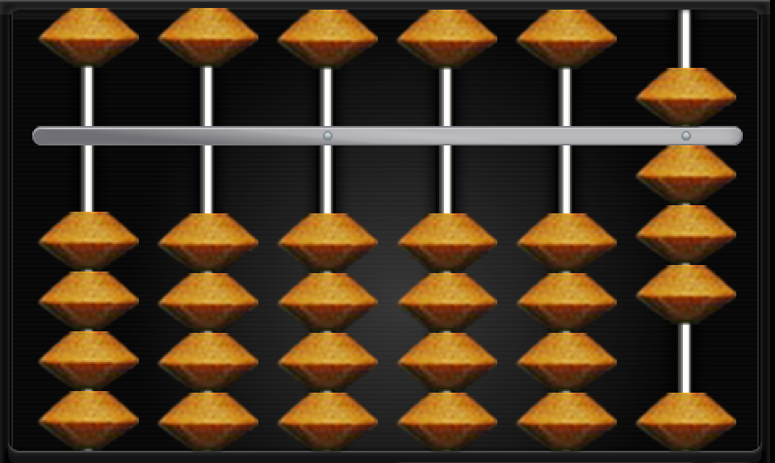
plus 8 -- minus 8
Notes:
Pinch to add 8; flick to minus 8. Use both index and thumb simultaneously to push all 8 beads together.

Slide 22
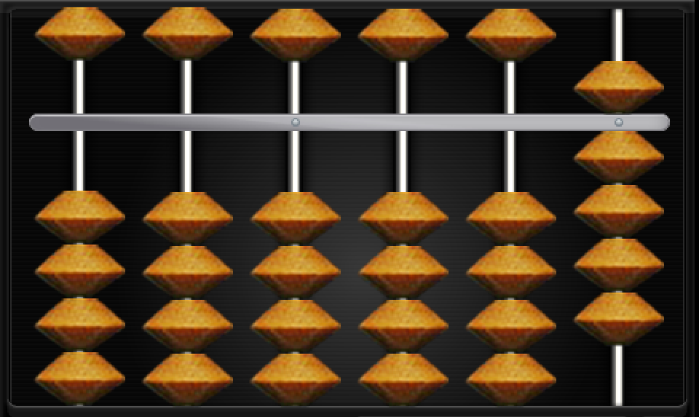
plus 9 -- minus 9
Notes:
Pinch to add 9; flick to minus 9. Use both index and thumb simultaneously to push all 7 beads together.

Slide 23
This is the end of
Lesson 1.

