Slide 1
TER ESL Courses
Dr. Fawzia Mai Tung

Slide 2
Why a different course?
All Foreign Language courses have only ONE curriculum/syllabus.
Either based on how to read/write
  Takes too long until can speak
  Speaks very slowly, with heavy accent
Or on spoken/useful phrases
  Very difficult to learn effective reading/writing
Solution:
  Combine TWO separate syllabi into ONE course.

Slide 3
Components of the course
Listening and Speaking
  Pimsleur Method
Reading and Writing
  Spalding Method
Culture:
  TER materials

Slide 4
Course Design
Each course lasts 5 weeks.
Each week: two classes
Each class: 1.5 hours
  30 minutes: listening and speaking
  30 minutes: reading and writing
  30 minutes: culture
Courses are designated:
  ESL 1, ESL 2, ESL 3, ESL 4, ESL 5
After ESL 5, most students are able to move to any other course or school work with no problems.

Slide 5
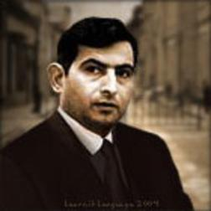
What is the Pimsleur Method?
Developed by Dr. Paul Pimsleur, a professor of French, education and romance languages, as well as one of the founders of ACTFL.
Widely recognized in the field of research in language acquisition.

Slide 6

Characteristics of the Pimsleur Method
Audio-based language acquisition
Stresses participation over rote memorization
During lessons, the listener repeats words and phrases given by native speakers and constructs new phrases by inference. As new phrases are introduced, the listener is prompted to recall older phrases. The prompts for any given phrase are gradually spaced out in ever-increasing intervals.

Slide 7
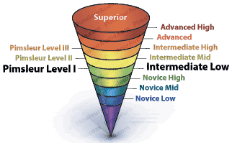
Characteristics of the Pimsleur Method (cont’d)
Focuses on proficiency in speaking
30-minute lessons
Repeat until reach 80% comprehension
Students listen to BOTH native and target languages
Responses are:
  A) repeated
  B) formed by student
Graduated intervals
Teaches blocks of words (functional units)

Slide 8
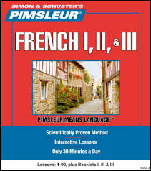
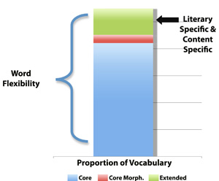
Four Principles
1: Anticipation
2: Graduated interval recall
3: Core vocabulary
4: Organic Learning

Slide 9

Use of Pimsleur in this course
Units 1-8 in ESL 1
8 units per course (40 total)
Be Flexible !
For languages not offered by Pimsleur, you must become familiar with the material by listening to the recordings for another language.
Then use the transcripts
Important: respect the time intervals!!!

Slide 10


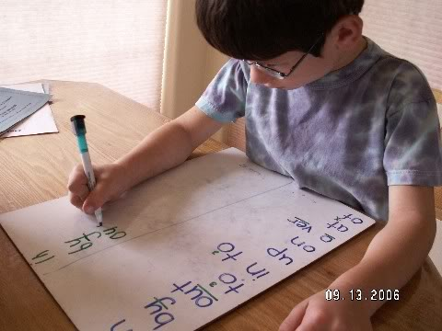
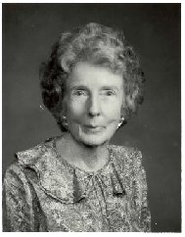
What is the Spalding Method?
See separate presentation

Slide 11
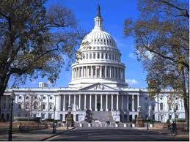
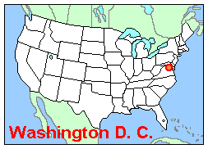


What are the culture materials?
Mostly power points developed by Tung Education Resources
Include:
  History
  Geography
  Culture
  Literature

Slide 12


What are the Vocabulary ppts?
Expand oral vocabulary
Based on core vocabulary from Pimsleur units
Only listening recognition required
Use as listed

Slide 13
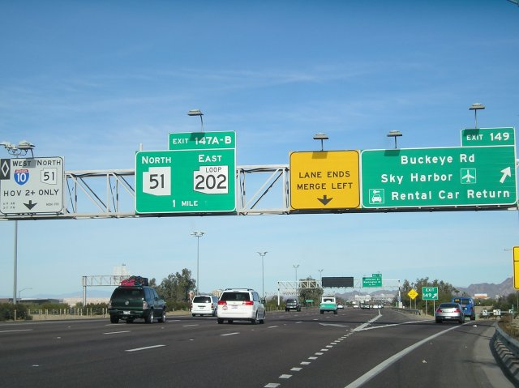

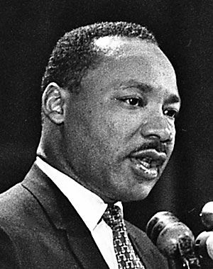
How to use the culture & vocabulary ppts
One per class at first
6 for course ESL 1
Thereafter:
  Be flexible
  Can be skipped if Reading and Writing take too much time
  Topic that pops up in the Reading material may be used for further cultural discussions

Slide 14
Thank You!

